Slide 1
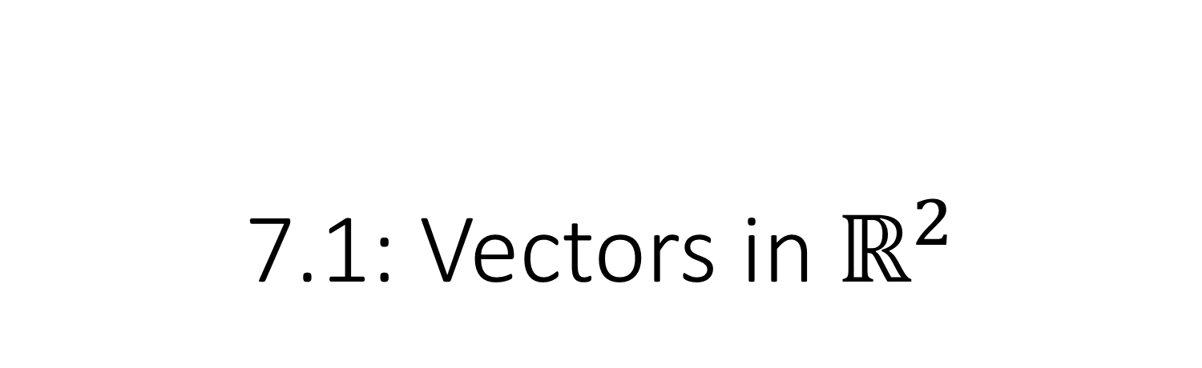
7.1: Vectors in $ℝ^{2}$
MATH 1550 - Precalculus

Slide 2

What is a Vector?
B
A vector is an arrow with an initial point A and terminal point B.
Denoted as a bold variable, $u$, or a variable with an arrow over it.
Has direction and magnitude (length, denoted $|u|$).
u
A
Scientific use of vectors: force, velocity, acceleration.

Slide 3



Scalars
v
$$\frac{1}{2}$$
v
v
v
$$2$$
$$−2$$

Slide 4
Vector Addition of two vectors, u + v
Note that we did not mention position as a characteristic of a vector;
only magnitude and direction. This lets us move the vectors wherever to our liking.
Tail-to-Tip Method
Parallelogram Method
Move tail of one vector to the tip of the other.
Draw another vector from the tail of u to the tip of v.
Place the tails of both vectors together.
Create a parallelogram.
The diagonal from the tails to the tips is the sum of u and v.
v
v
u + v
u + v
u
u

Slide 5
Graphical Subtraction of Vectors
v
v
u + v
u
u – v
–v
u

Slide 6


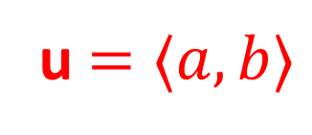

Vectors in $ℝ^{2}$
$$a$$
u $=⟨a,b⟩$
Vectors assume no position. Only direction and length.
Vectors can be moved wherever we want.
For convenience, we can place them at the origin.
u
$$b$$

Slide 7
Graphical Subtraction of Vectors
v
v
u + v
u
u – v
–v
u

Slide 8
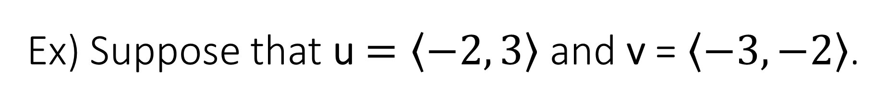
Ex) Suppose that u $=\left\langle −2\right.,\left.3\right\rangle$ and v = $\left\langle −3\right.,\left.−2\right\rangle$.
Compute u – 2v.
Find x such that 3u + x = –v.

Slide 9
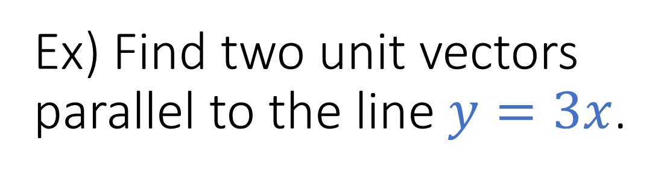
Ex) Find two unit vectors parallel to the line $y=3x$.
3
-1
1
-3

Slide 10
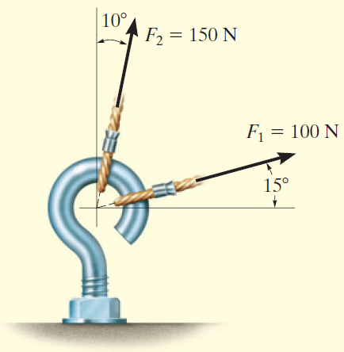
Ex) The forces F₁, F₂ act on the screw eye below. Find the magnitude of the resultant force.
150 N
115⁰
100 N

Slide 11
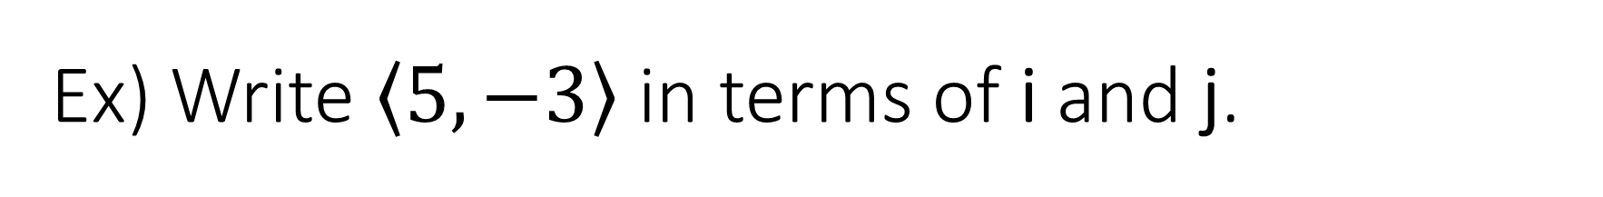
Ex) Write $\left\langle 5\right.,\left.−3\right\rangle$ in terms of i and j.

